Slide 1
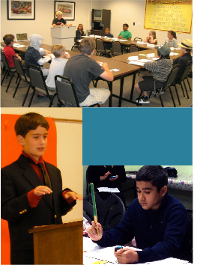


Join the Club!
Norfolk Middle School
^{Speakers League}
"I really like Speakers League. It's not just about standing up and speaking for a few minutes, it's about having a blast doing it.”
^{- James K. (Age 13)}
Meets 2nd & 4th Mondays, starting October 9th from 4:00pm - 5:30pm in Classroom 2B. For more information or to join, contact Mrs. Holmes.
Presentation Techniques
Mental Agility
Meeting Management
Critical Thinking
Leadership
Organizational Skills
Speech Writing
√
√
√
√
√
√
√
A supportive environment where you can become
more comfortable and confident with public speaking.
There are three main segments at meetings:
Impromptus, during which members rise and reply, off-the-cuff, for two-minutes, to questions or topics, prepared speeches that emphasize different speech-crafting and presentation skills, and evaluations that follow club guidelines for constructive critiques.
Each Speech Develops New Skills
The speeches you will give in Level I isolate and build skills gradually. For example, in one of the speeches, you will focus on using effective gestures, in another, using vocal variety, and in the another, visual aids. Each speech emphasizes something different to improve your overall presentation skills.
^{Comprehensive Materials}
When you join Speakers League you will receive your
45-page Member Handbook encompassing the materials for Levels I and II, including speech and speech-writing guidelines and how to do each of the roles at a meeting, plus other bonus material.
Come be a part of the fun, learning skills that will last a lifetime!
As a member of a Speakers League club, not only will you learn how to write and present a great speech, you will also learn how to organize your thoughts quickly to speak “off
"Be on the lookout for Millennials who have participated in speech and debate training. Hire them
and put them on your leadership fast track.”
- Robert Sher
“How to Find Millennials Who Will Lead Your Company.”
Forbes.com. March 2, 2014
^{the cuff,”}
and how to evaluate other members’ speeches in
a way that is “constructive” instead of “destructive.”
^{You’ll} learn how to manage a meeting and do the different roles – MC, Impromptu Master, Evaluator, Timekeeper, Wordmaster, Humorist, Vote Counter, and Poet Laureate.

